Slide 1


Slide 2
Hosting a static website on EC2

Slide 3
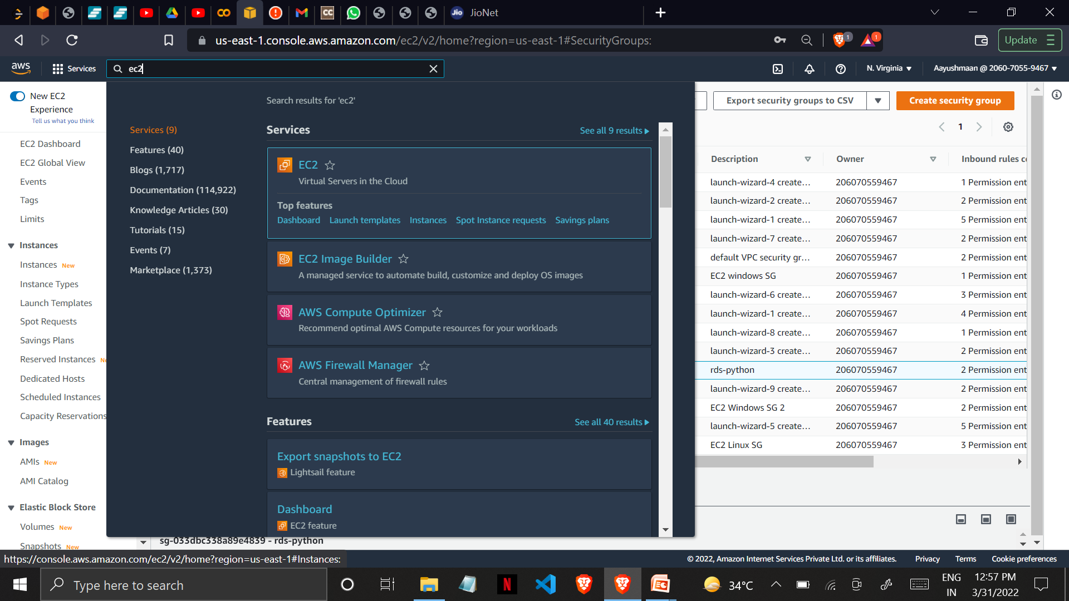
1. Sign in to your AWS Account(Root/IAM) 2. Search for the service EC2 and click on Instances

Slide 4
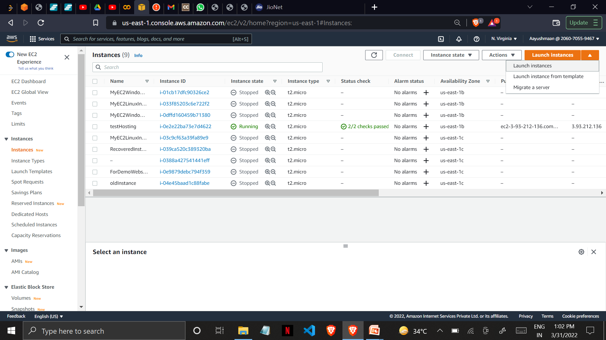
3. Click on launch instance

Slide 5
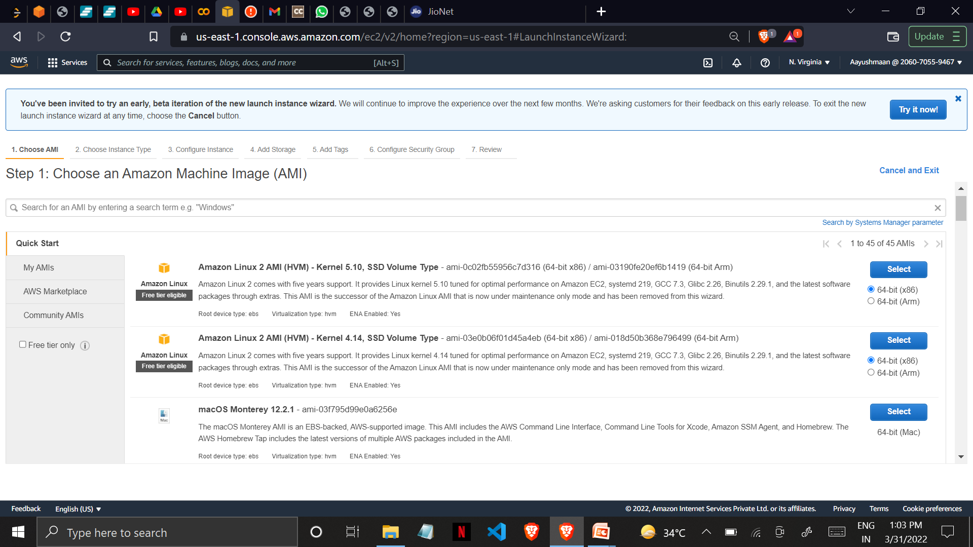
4. Choose an AMI AMI stands for Amazon Machine Image basically here you’re choosing an operating system for your EC2 Instance.

Slide 6
Amazon EC2 provides a wide selection of instance types optimized to fit different use cases. Instances are virtual servers that can run applications. They have varying combinations of CPU, memory, storage, and networking capacity, and give you the flexibility to choose the appropriate mix of resources for your applications.

Slide 7
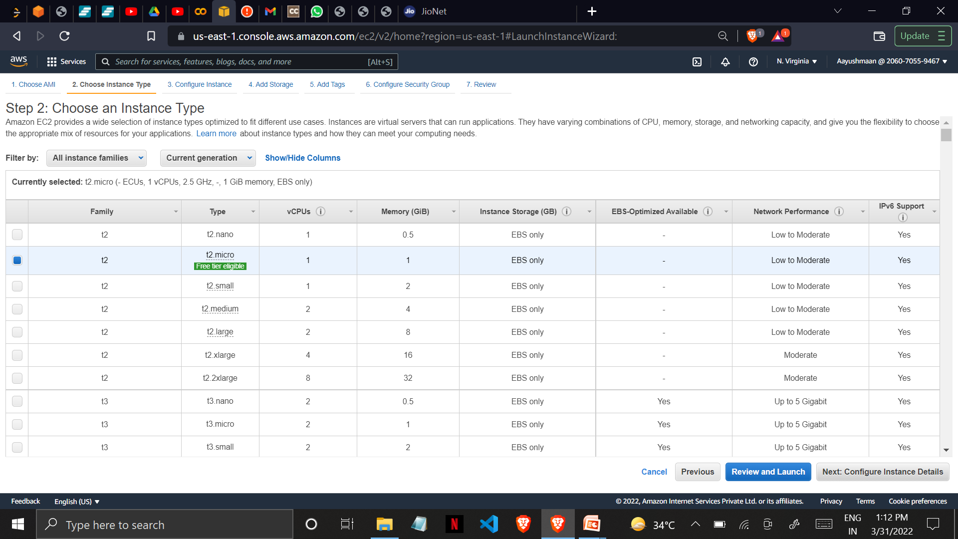
5. Choose an Instance Type here we’re choosing t2.micro as it is free tier eligible.

Slide 8
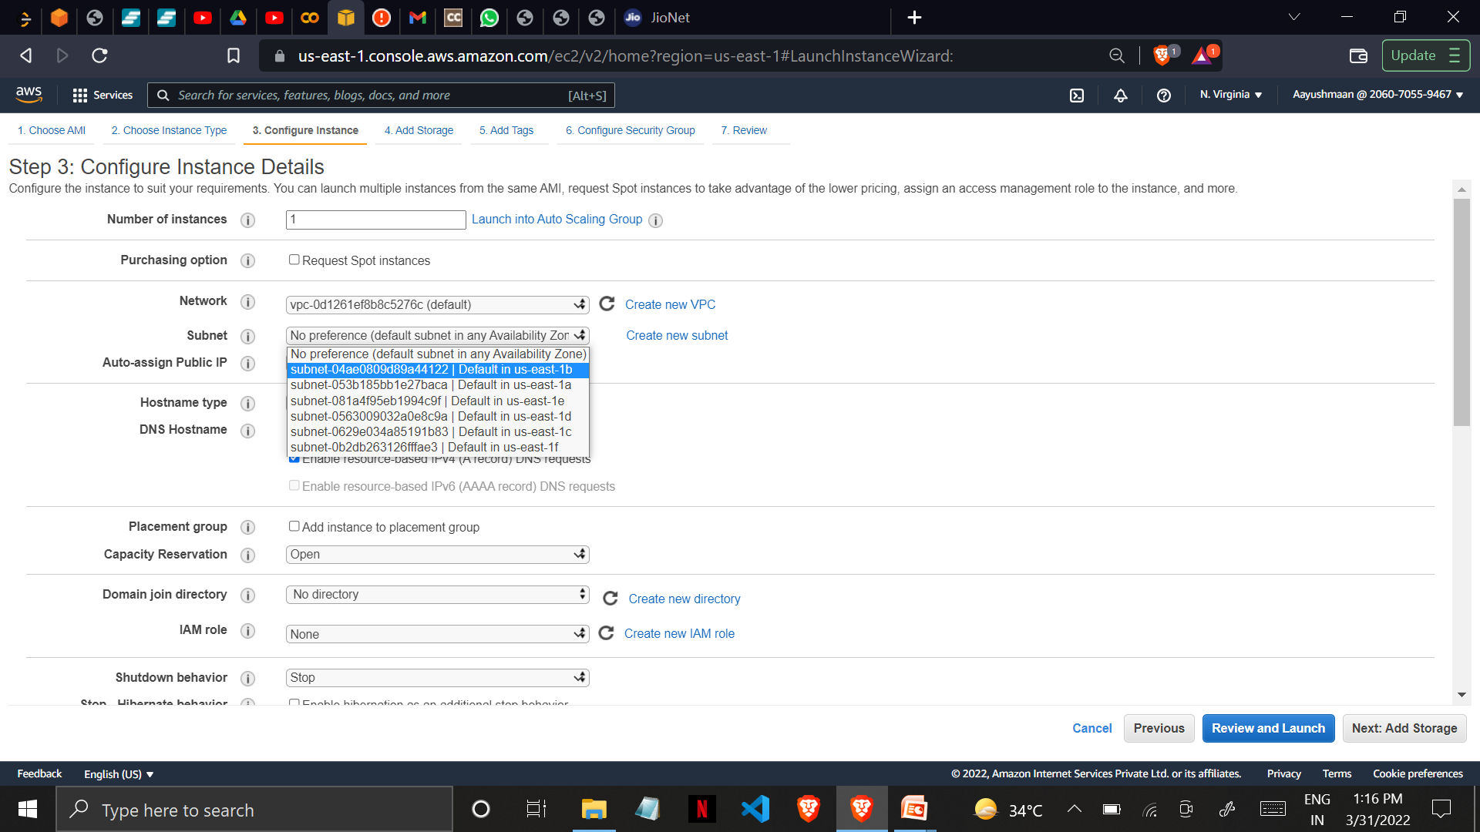
6. Configure Instance Details here we can select the number of instances we wish to launch or we can also select the subnet Availability zones. Keeping rest of the configurations as default we proceed to add storage.

Slide 9
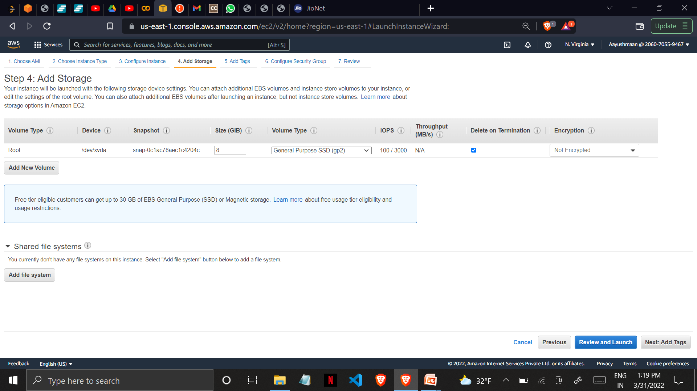
7. Add Storage Your instance will be launched with the following storage device settings. You can attach additional EBS volumes and instance store volumes to your instance, or edit the settings of the root volume. You can also attach additional EBS volumes after launching an instance.

Slide 10
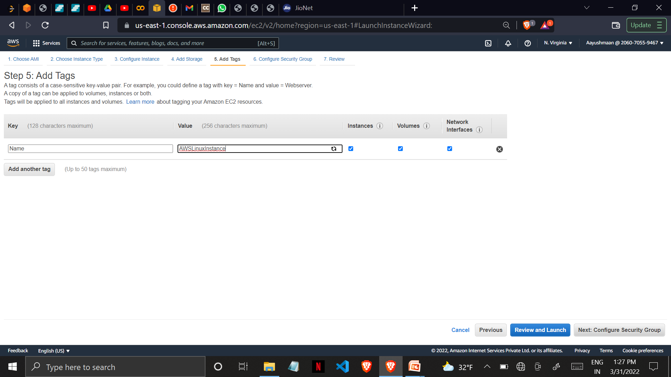
8.Add Tags (optional) A tag consists of a case-sensitive key-value pair. For example, you could define a tag with key = Name and value = AWSLinuxInstance A copy of a tag can be applied to volumes, instances or both.

Slide 11
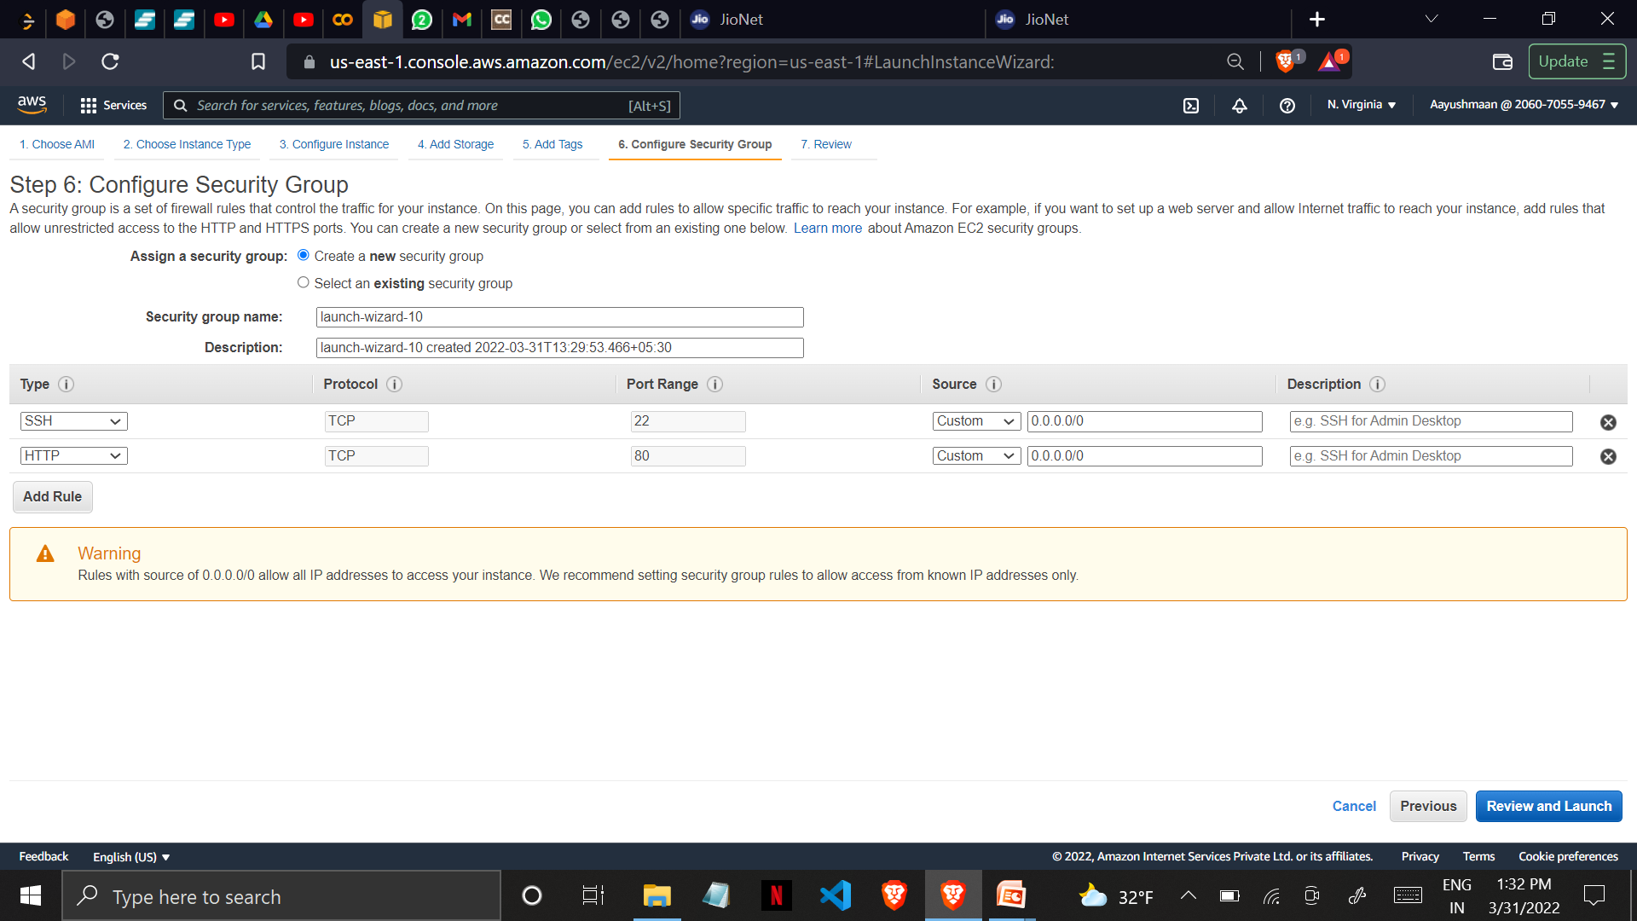
9. Add security groups A security group is a set of firewall rules that control the traffic for your instance. On this page, you can add rules to allow specific traffic to reach your instance. For example, if you want to set up a web server and allow Internet traffic to reach your instance, add rules that allow unrestricted access to the HTTP and HTTPS ports. You can create a new security group or select from an existing one below.

Slide 12
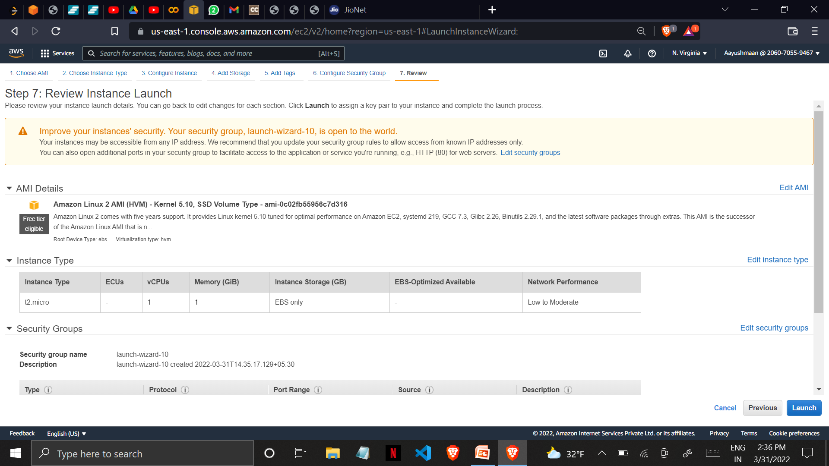
10. Review Instance Launch here you can review your instance launch details. You can go back to edit changes for each section. Click Launch to assign a key pair to your instance and complete the launch process.

Slide 13
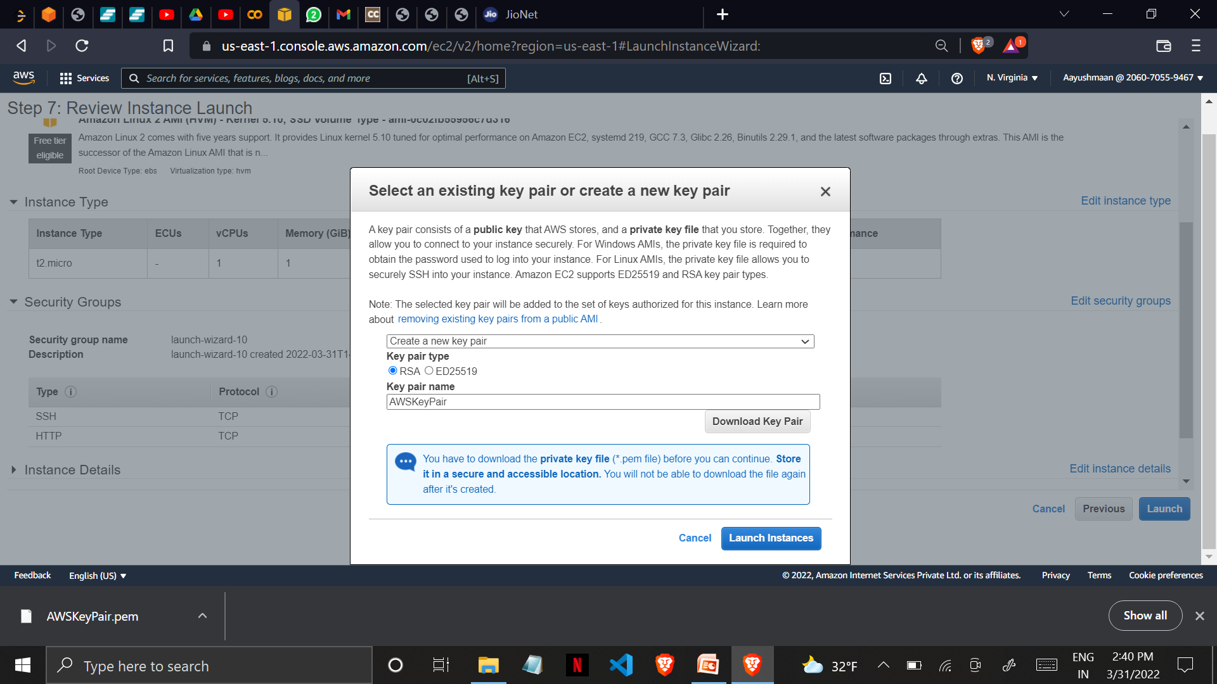
11. Download Key Pair A key pair consists of a public key that AWS stores, and a private key file that you store. Together, they allow you to connect to your instance securely. For Windows AMIs, the private key file is required to obtain the password used to log into your instance. For Linux AMIs, the private key file allows you to securely SSH into your instance.

Slide 14
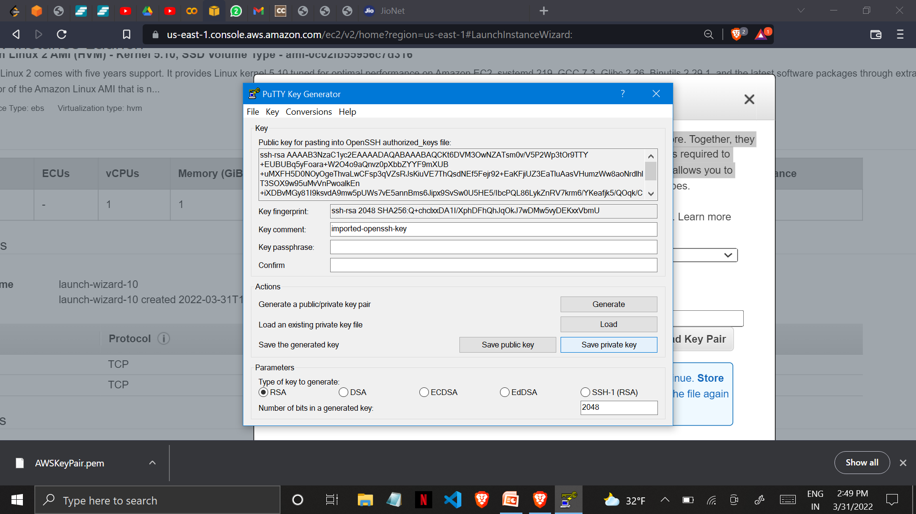
12. Use puTTY GEN to convert the key pair from .pem format to .ppk format

Slide 15
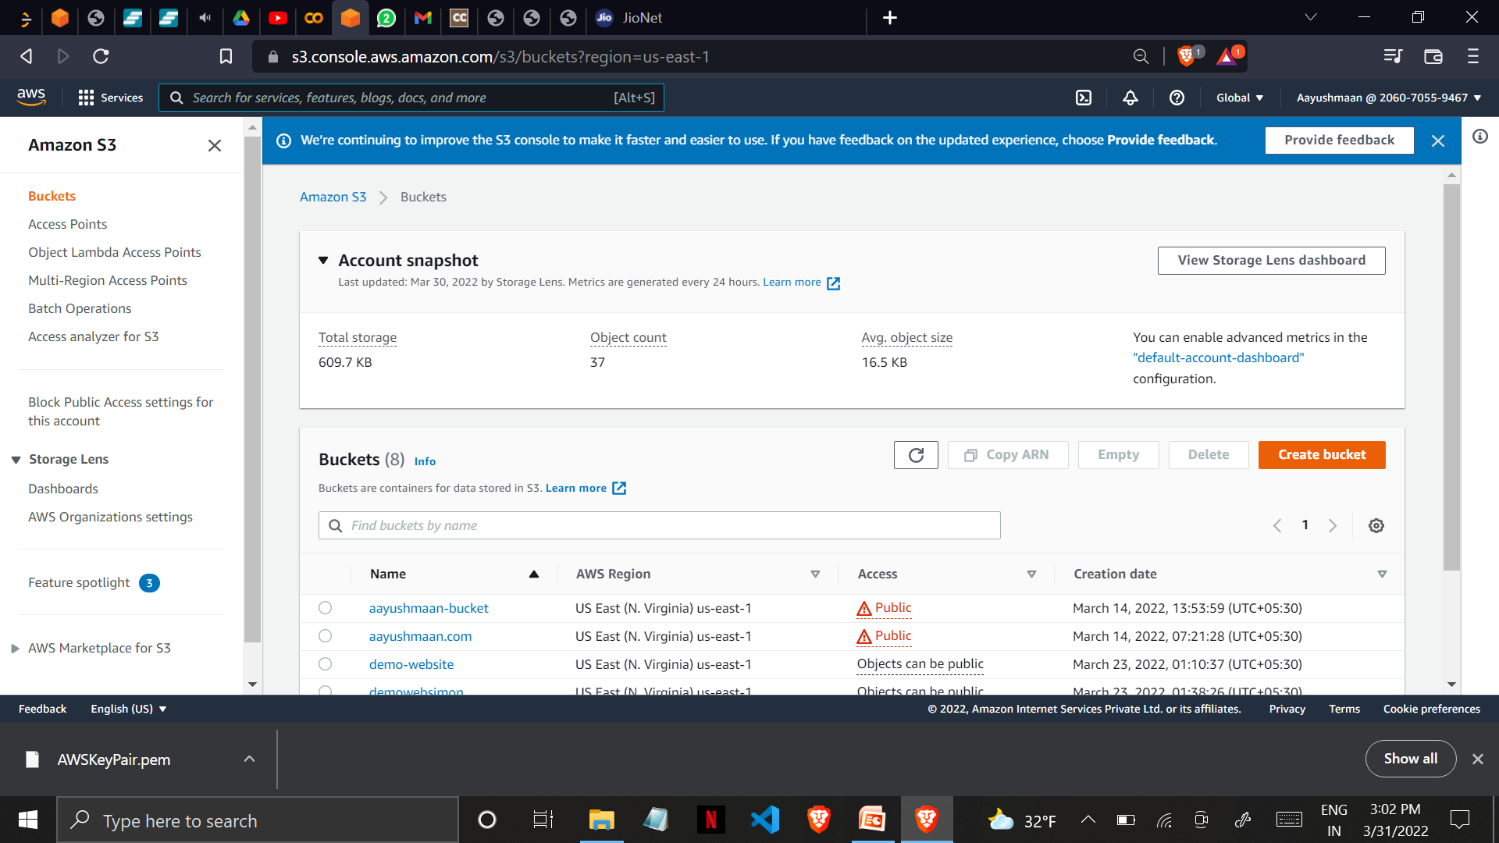
13. Now open S3 bucket and create a new empty bucket Every object in S3 is stored in a bucket. To upload files and folders to S3, you’ll need to create a bucket where the objects will be stored.

Slide 16
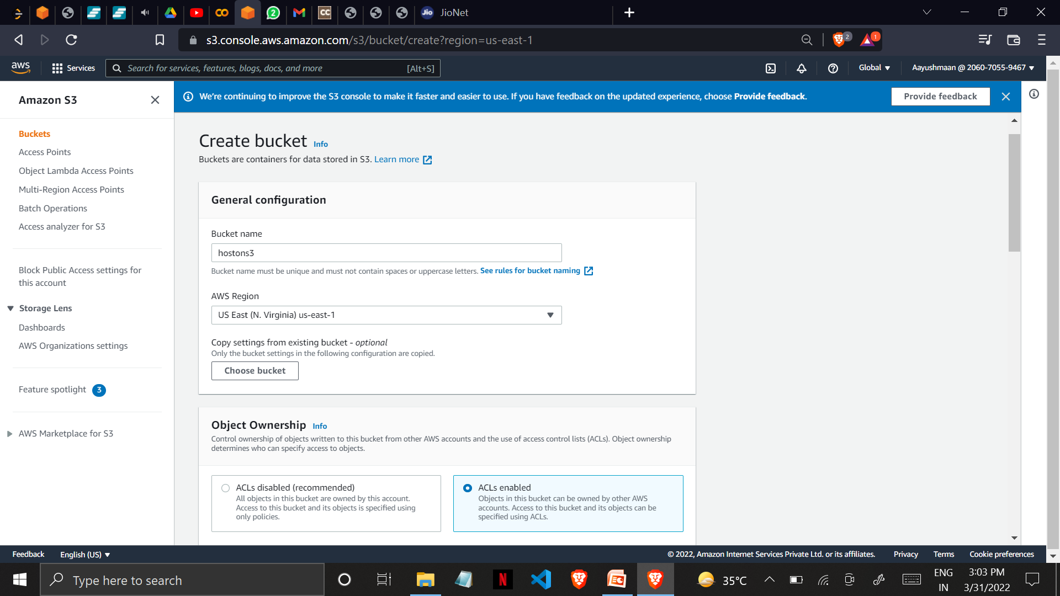
14. Give your bucket a unique name[uppercase & whitespaces are not allowed] We should keep ACL(Access Control List) enabled in order to access bucket and its objects.

Slide 17
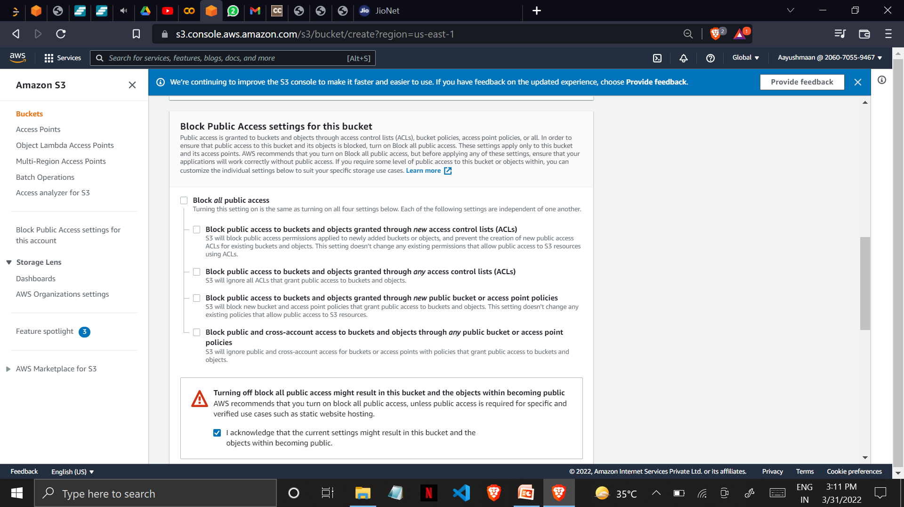
15. Un-check “Block all public access” and proceed to create bucket

Slide 18
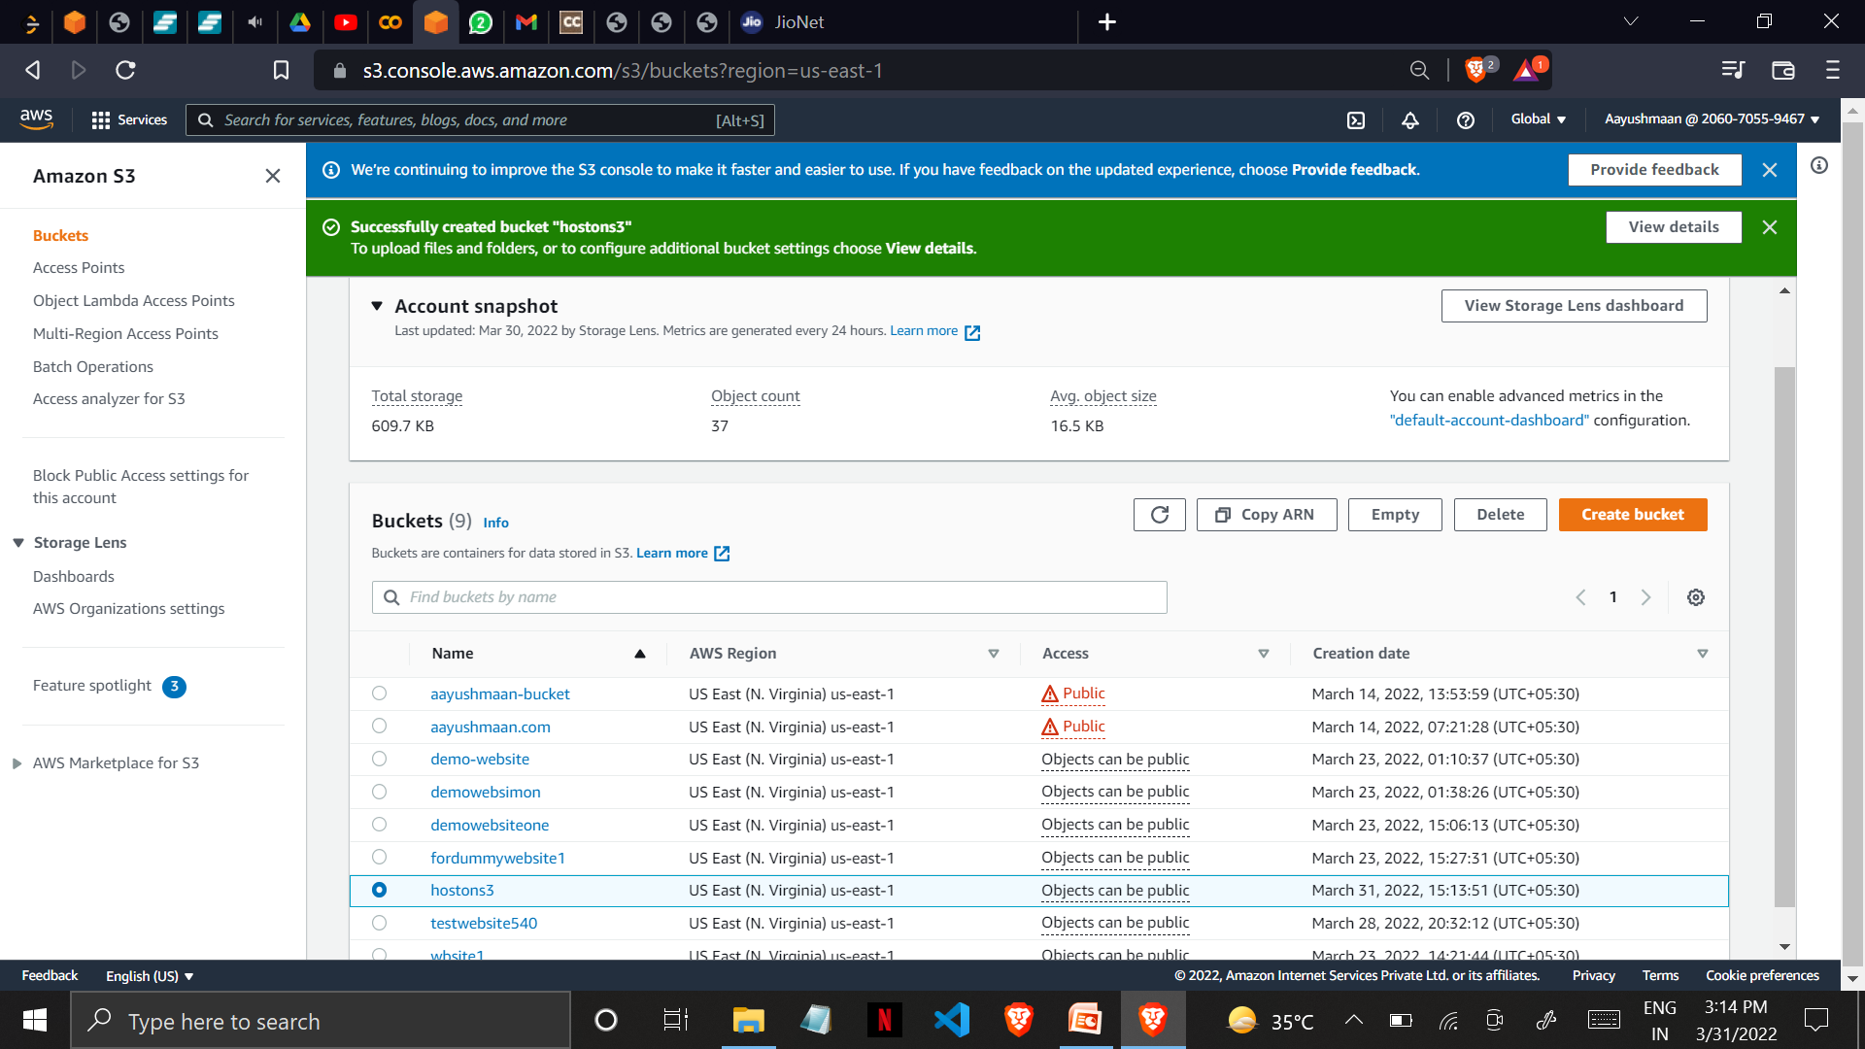
Once the bucket has been created you can see a “Bucket created successfully” message.

Slide 19
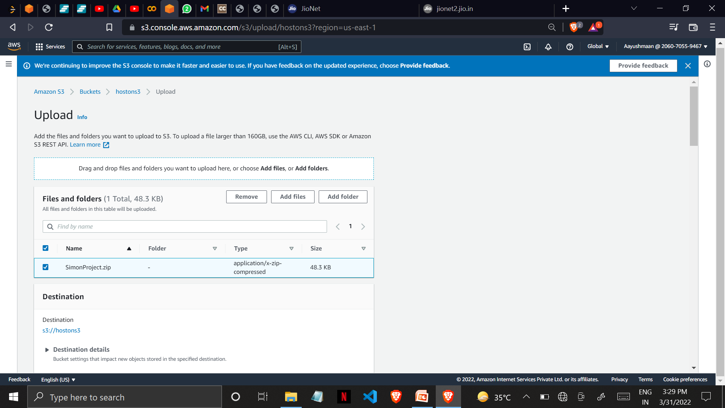
16. Make a zip file of the folder where all of your static website files exists, and upload to S3 bucket.

Slide 20
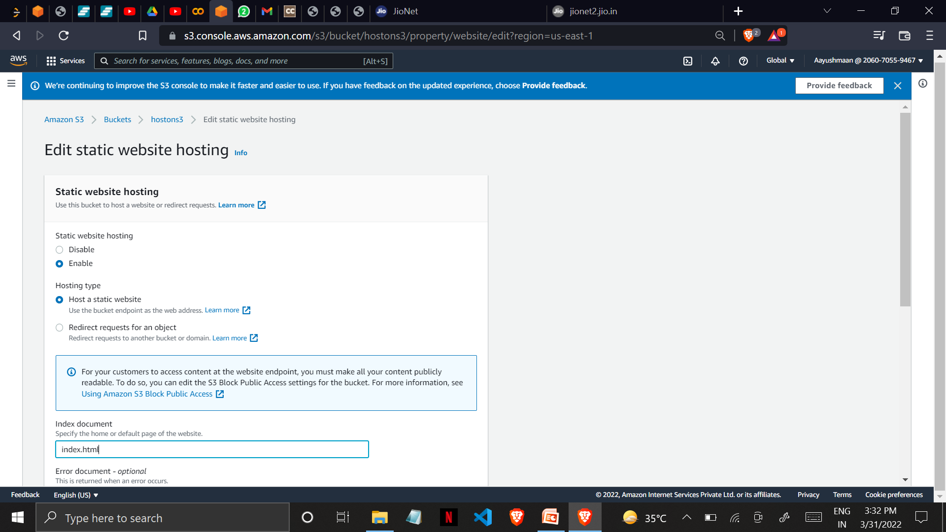
17. goto S3 properties and enable “static website hosting”

Slide 21
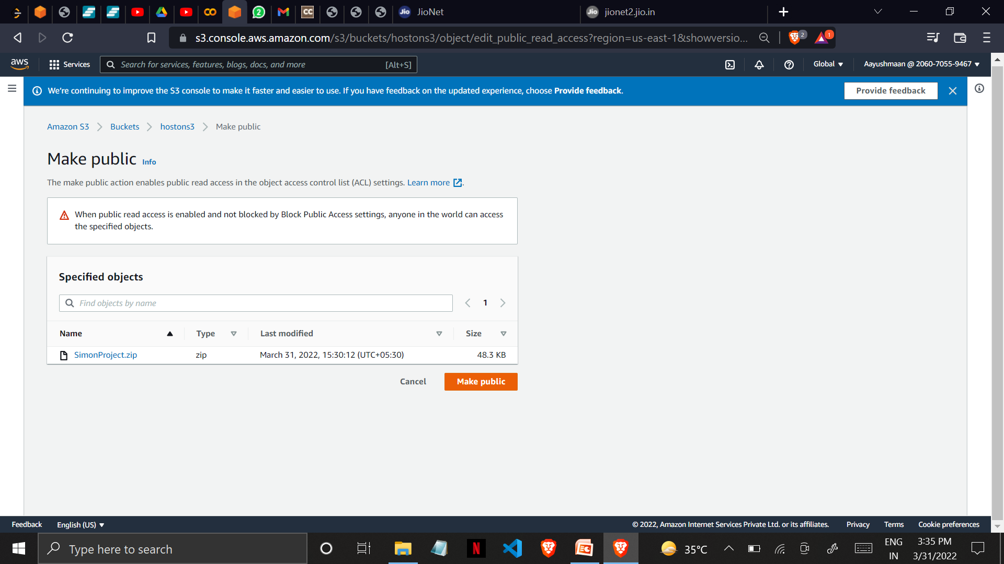
18. Select the zip file and goto Actions and make it public using ACL. The make public action enables public read access in the object access control list (ACL) settings

Slide 22
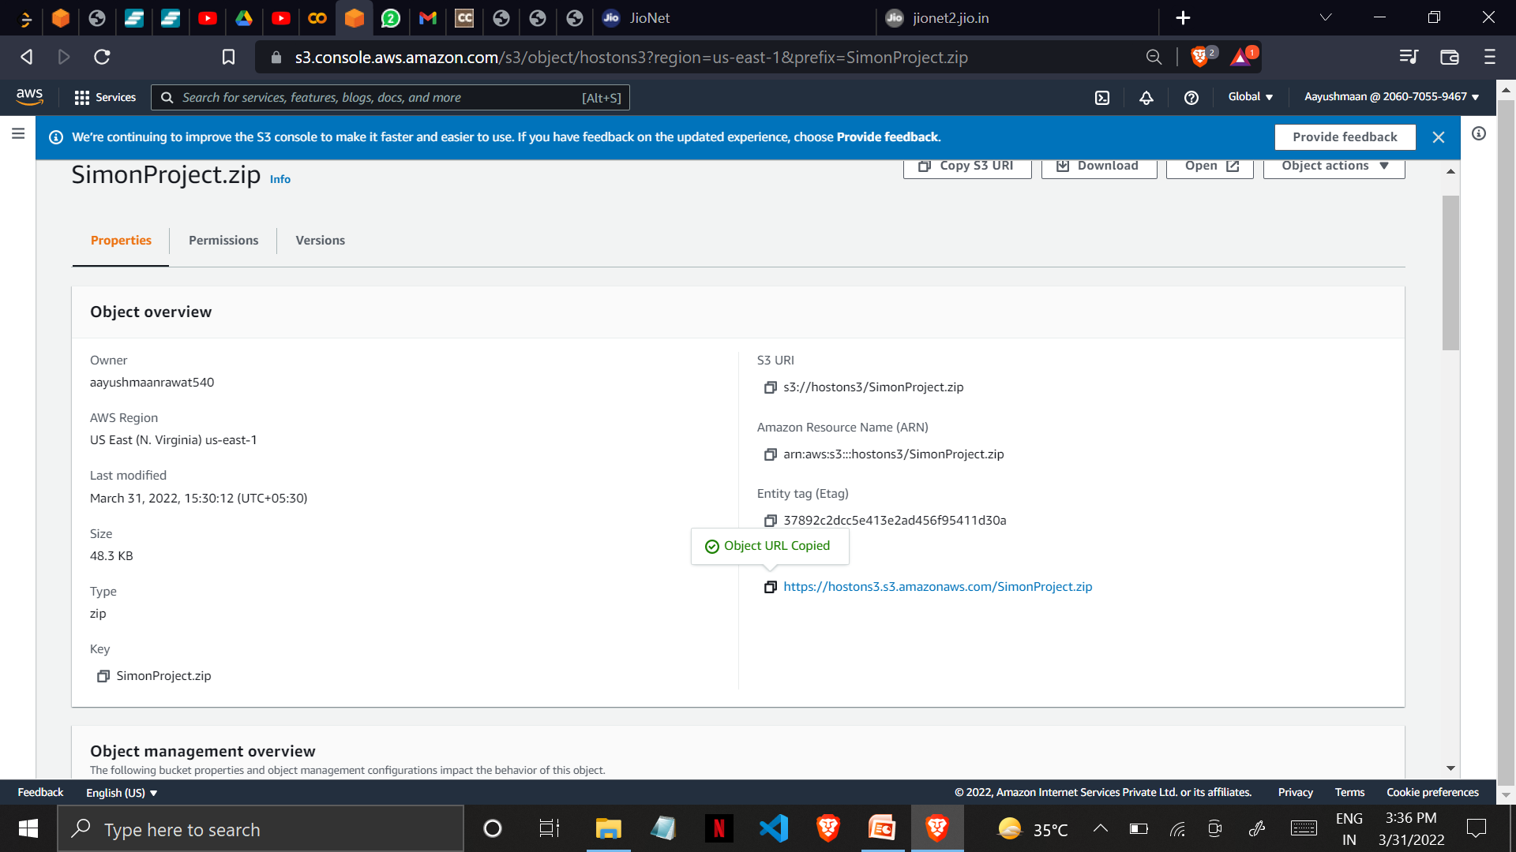
19. Note the S3 Object URL

Slide 23
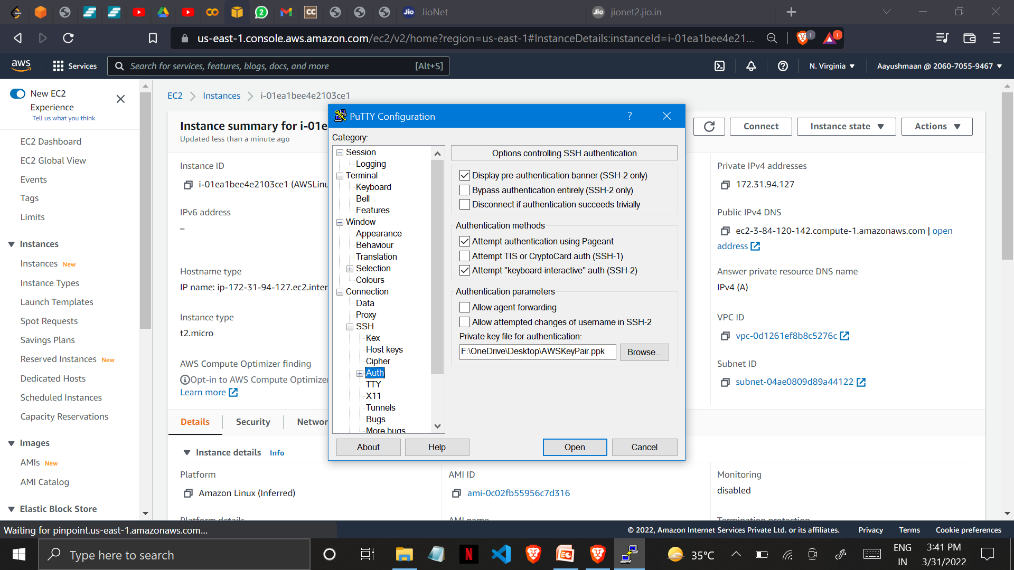
20. Now open puTTY to launch the EC2 Linux Instance goto SSH-> Auth -> Upload .ppk file and copy the public ip in place of Hostname and click on open.

Slide 24
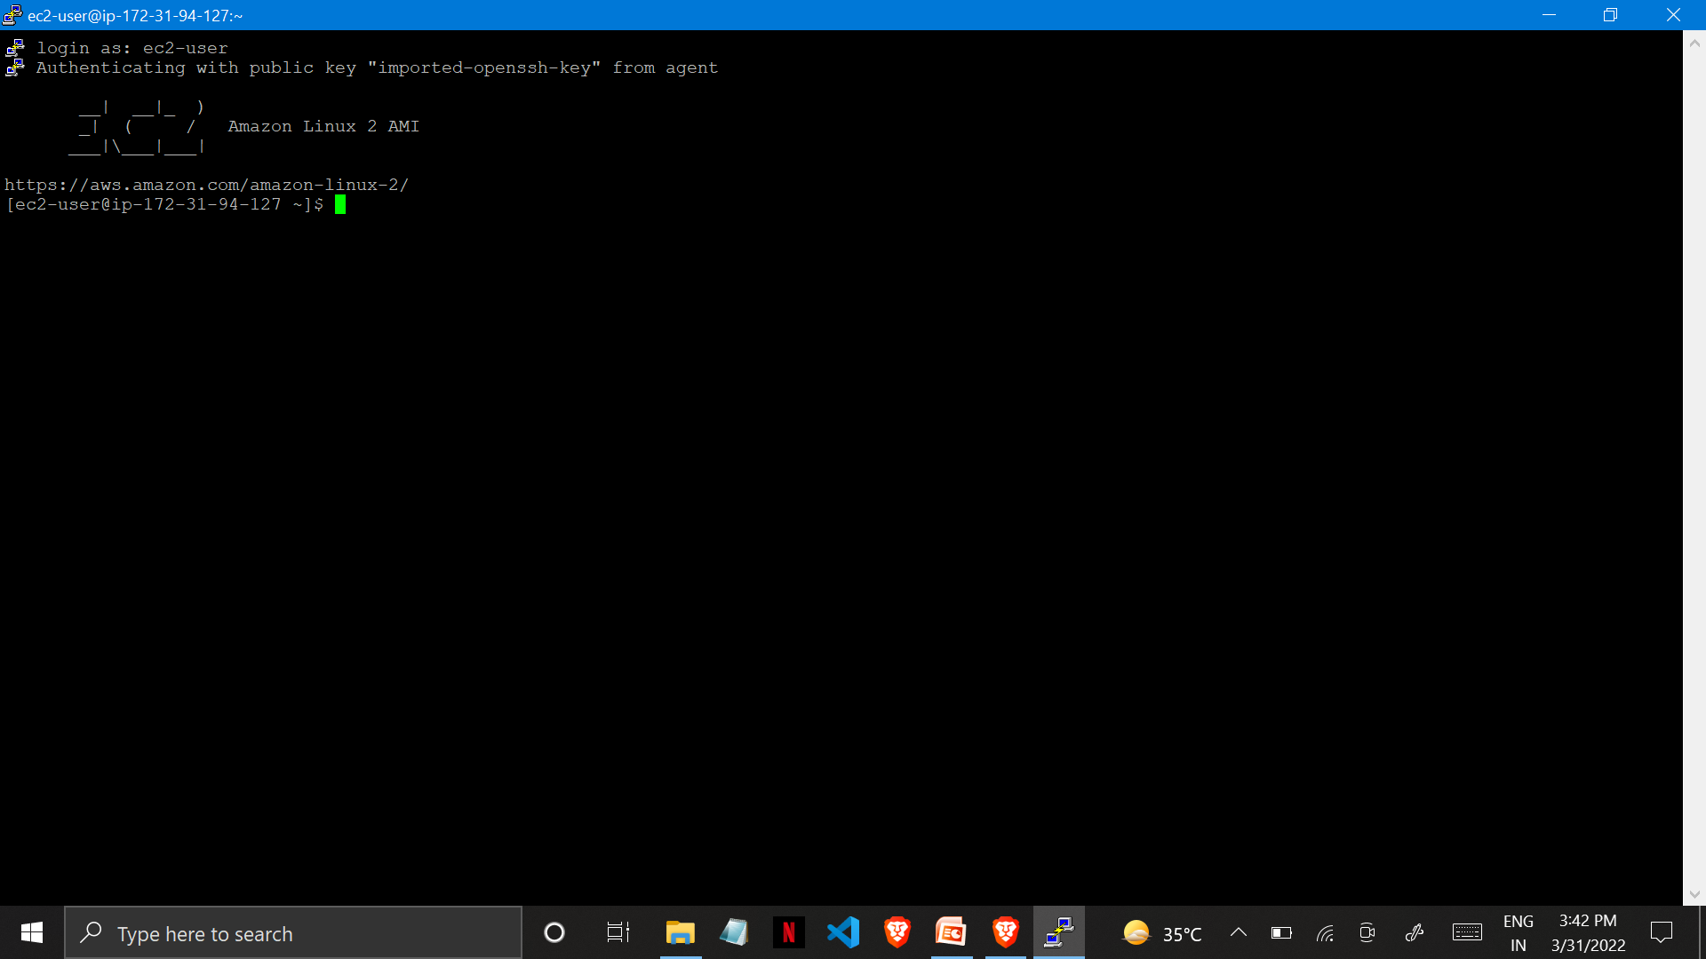
EC2 Linux Instance has been launched

Slide 25
Now run the following commands in order to host the website Commands Description sudo su to get root access yum update –y to update the package in EC2 Instance yum install httpd –y to install Apache Server pwd to check the path cd /var/www/html for changing the directory ls to check whether any directory files are available wget https://hostons3.s3.amazonaws.com/SimonProject.zip to get files from S3 ls to check whether any directory files are available unzip SimonGame.zip for unzipping the zip file mv SimonProject /* . for moving all the files to EC2 ls to check whether any directory files are available service httpd start to start Apache Server

Slide 26
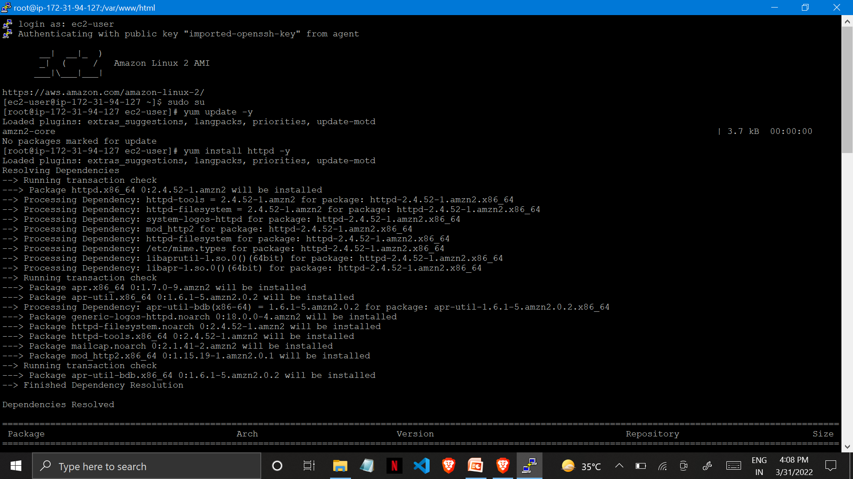

Slide 27
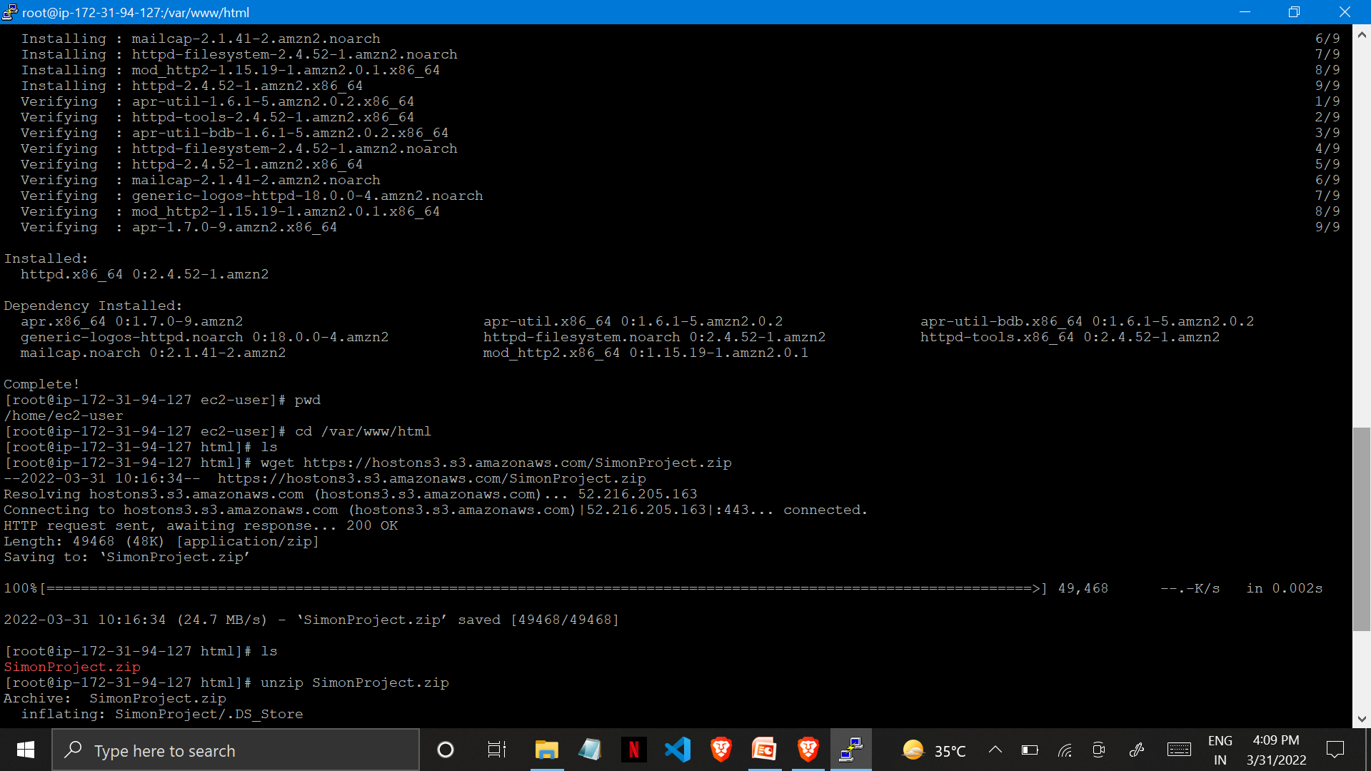

Slide 28
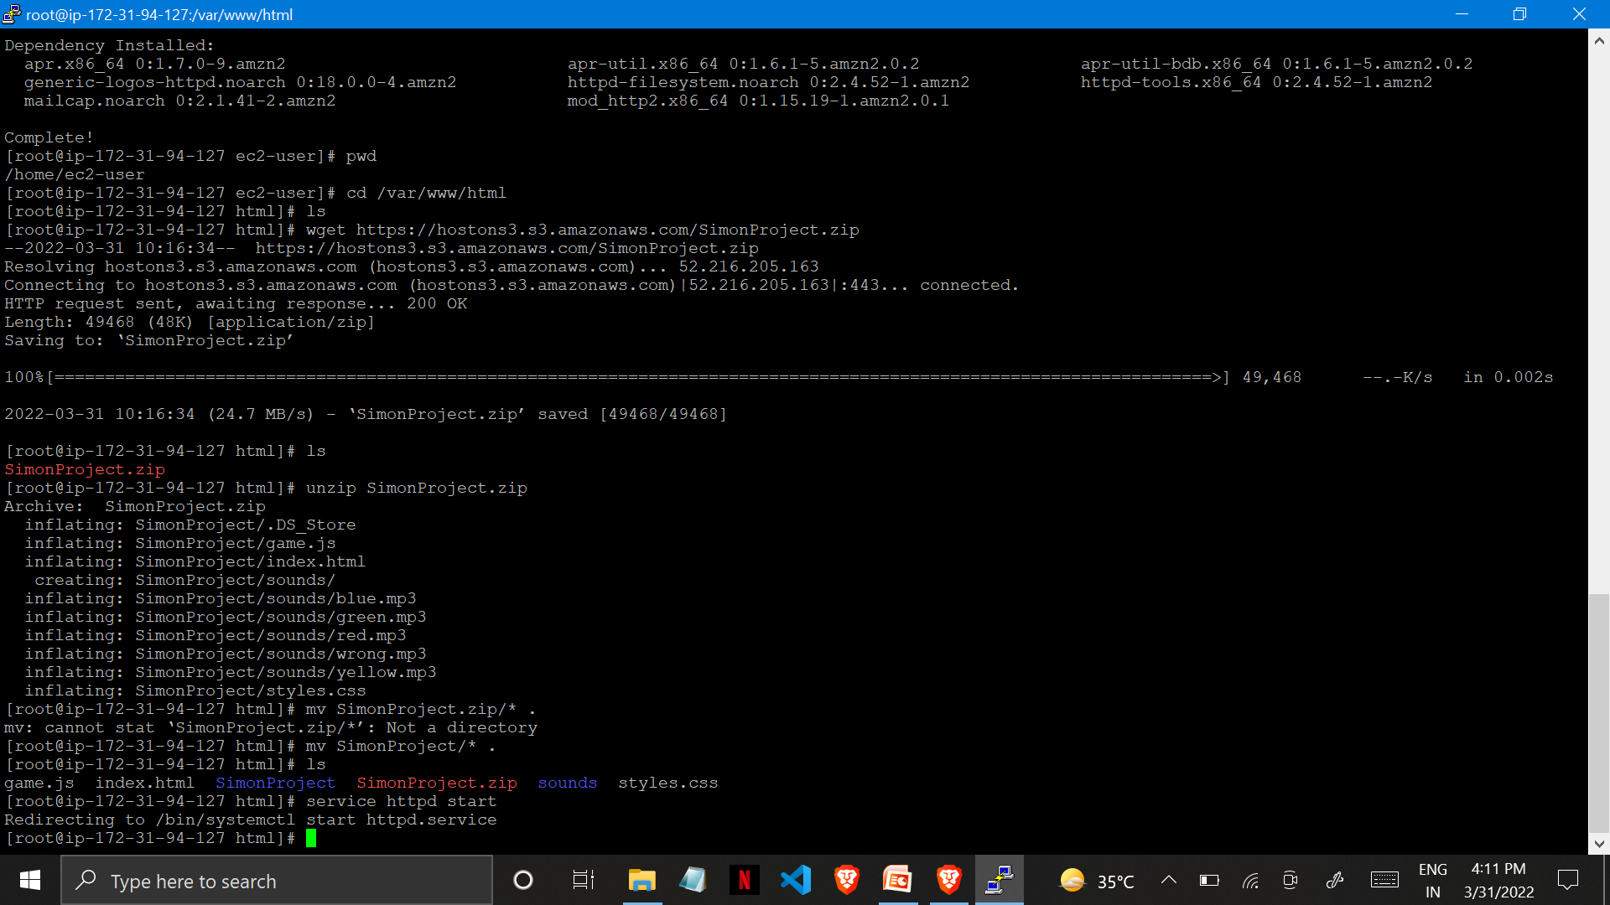

Slide 29
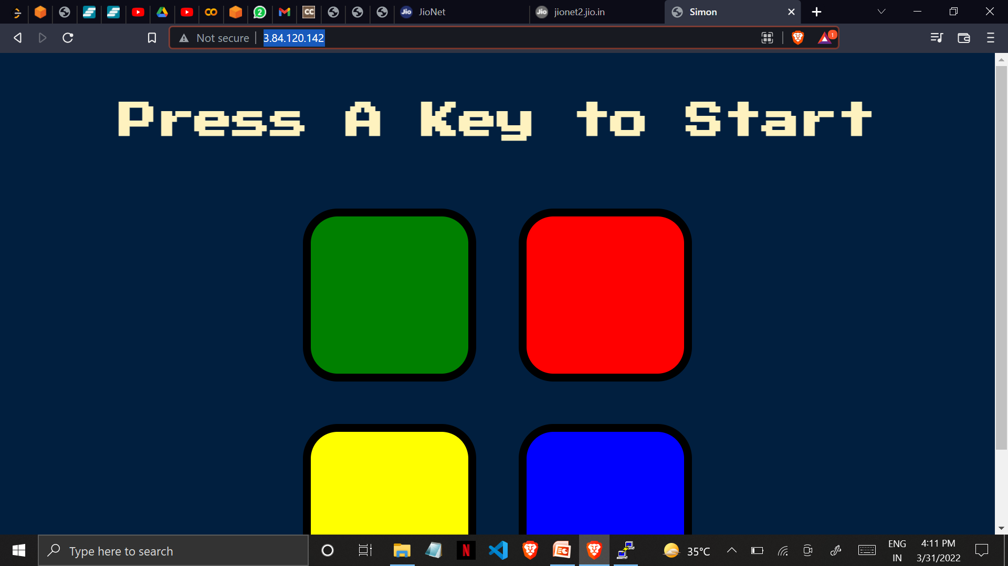
Now copy the Public IP of the EC2 Instance and paste it into the Web Brower. Your static website got hosted on EC2 @ http://3.84.120.142/

Slide 30
THANK YOU :) By- Aayushmaan Rawat (B-Tech CSE 2019-23)

